Slide 1
Identifying Preferred Helicopter Landing Zones using Python
Jeff Babinowich
GEOG 6293
16 December 2015

Slide 2
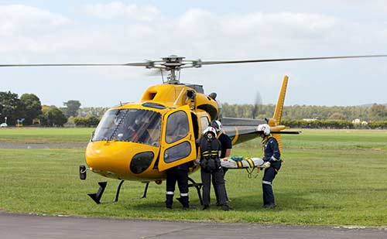
Objective
To identify suitable Helicopter Landing Zones (HLZs) within a 2.5 kilometer radius of a distressed hiker
Case study will use Yellowstone National Park
A quick extraction of a distressed person or causality can greatly improve the chance of survival
Department of Homeland Security and Department of Defense have issued guidelines for safe HLZs
Slope can not exceed 7 degrees
Land Cover of the HLZ should be clear of large trees and other obstructions
Preferred United States Geology Survey Land Cover Codes are: 31 = Barren, 52 = Shrub/Scrub, 71 = Grassland/Herbaceous, 81 = Pasture/Hay, 82 = Cultivated Crops
The HLZ should not be too close to Rivers or Lakes
The HLZ should be at minimum 20,000 square meters

Slide 3
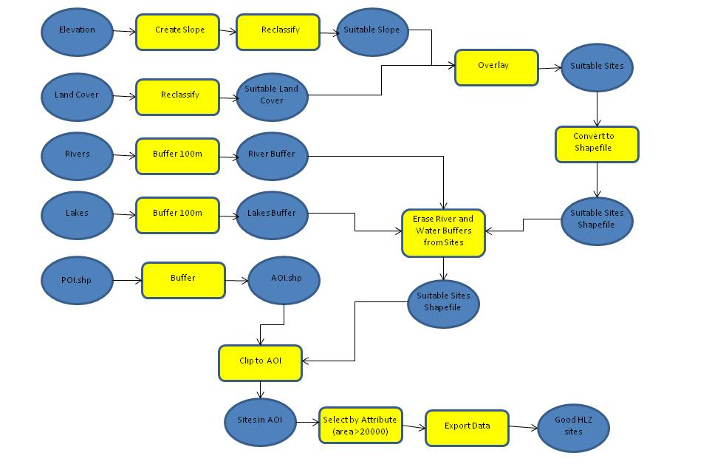
Original Flowchart

Slide 4
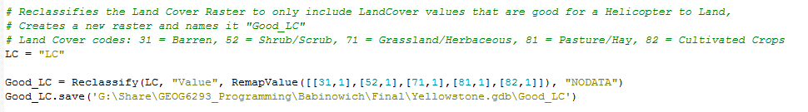
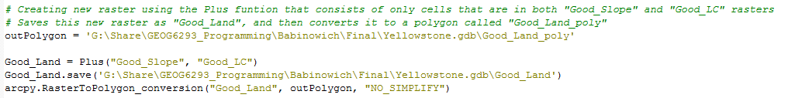
Coding Examples
Reclassifying the Land Cover to only include the preferred Land Cover types
Difficult because there were multiple values I wanted to include in the reclassify
Join the Good Slope and the Good Land Cover together so only the cells that were within both rasters are included
Found the Plus feature would to accomplish this

Slide 5
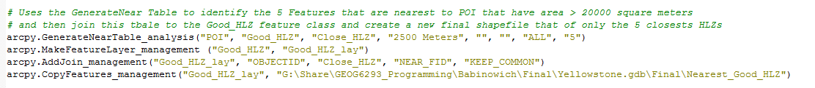
“Bonus” Code & Future Improvements
Took the project a step further to identify the 5 closest HLZs that met the criteria to the Point where the distressed hiker was reported
Found that I could use GenerateNearTable to create a table of a specific number of features nearest the Point of Interest
Future improvements to the code
Allow the user to input the required variables, including Point of Interest
Allow the user to input the area the HLZ needs to be for specific helicopters to safely land
Clipping layers and rasters to the Area of Interest from the beginning, to save processing time

Slide 6
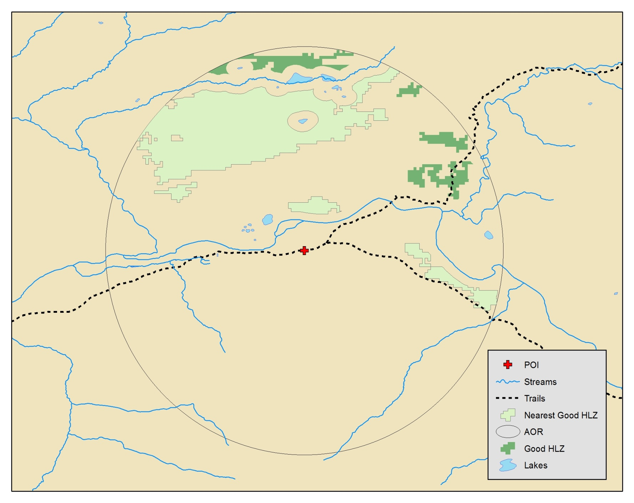
Final Output – Yellowstone NP

Slide 7
Questions?

